Slide 1

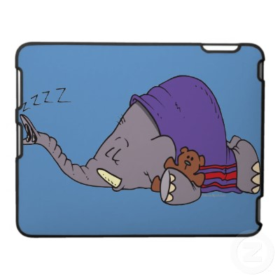
Sleeping Elephants Game

Slide 2
고개를 숙인다
자기 차례가 되면 고개를 들고 자기 낱말을 확인한 뒤 고개를 숙인다.
Wake up! 시간에 모두 고개를 든다
Write down 시간에 의논하여 쓴다(단어 순서는 섞여 있음)

Slide 3
4
3
Everyone head down
2
1

Slide 4
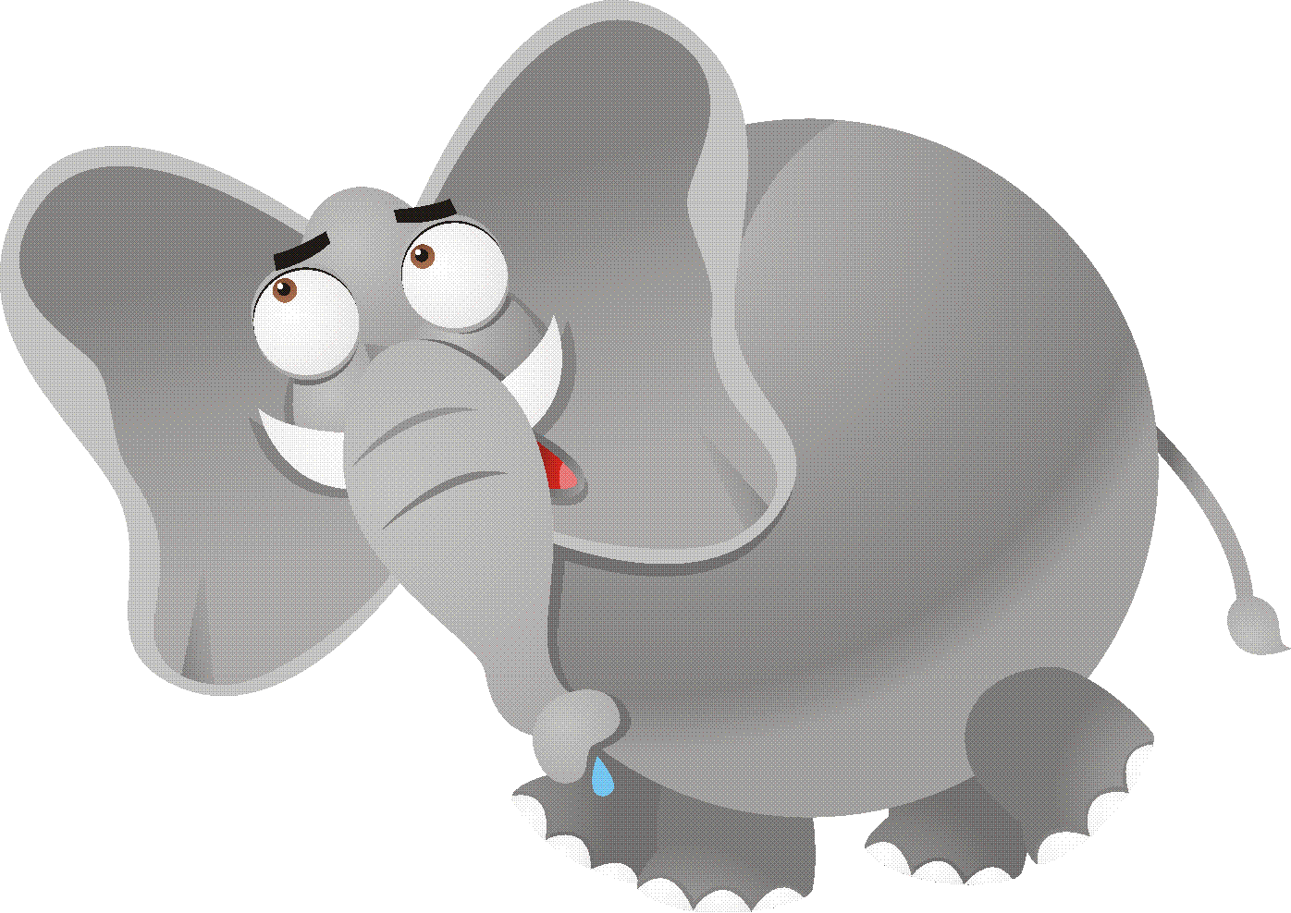
Elephant 1
4
3
this?
2
1

Slide 5
Sleeping Elephants
4
3
2
1

Slide 6
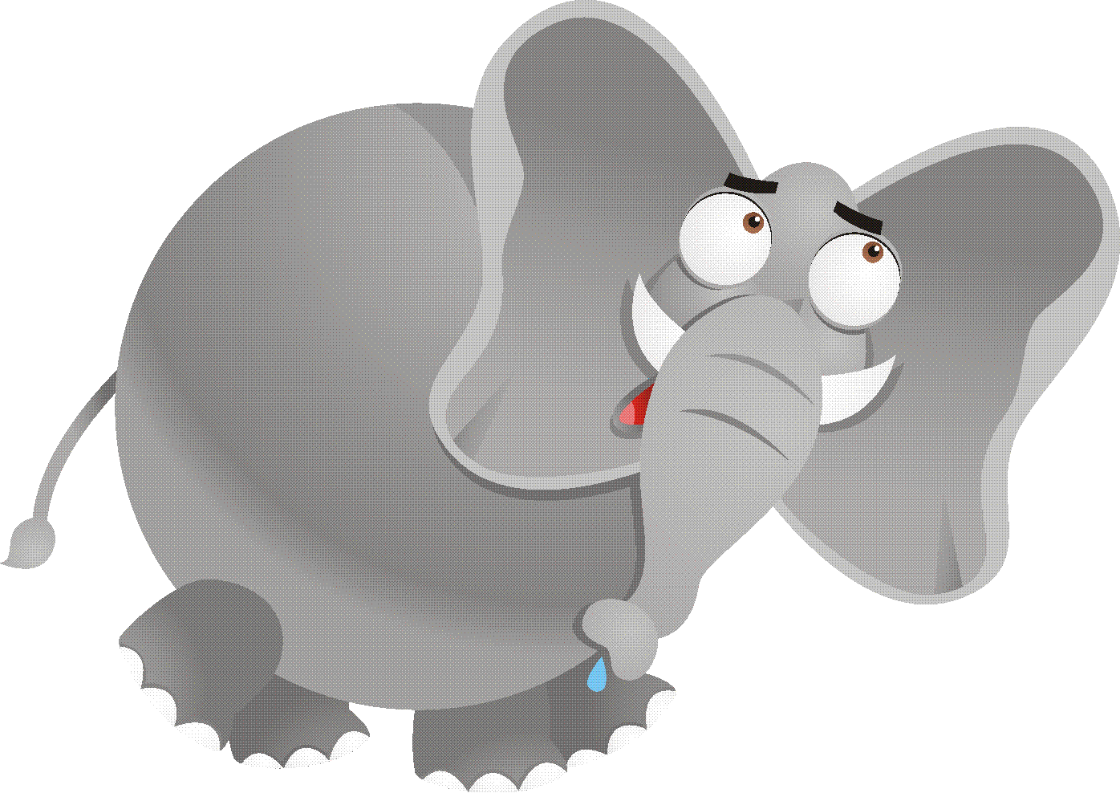
Elephant 2
4
3
bottle
2
1

Slide 7
Sleeping Elephants
4
3
2
1

Slide 8
Elephant 3
4
Whose
3
2
1

Slide 9
Sleeping Elephants
4
3
2
1

Slide 10
Elephant 4
is
4
3
2
1

Slide 11
Sleeping Elephants
4
3
2
1

Slide 12
Wake Up!
4
3
2
1

Slide 13

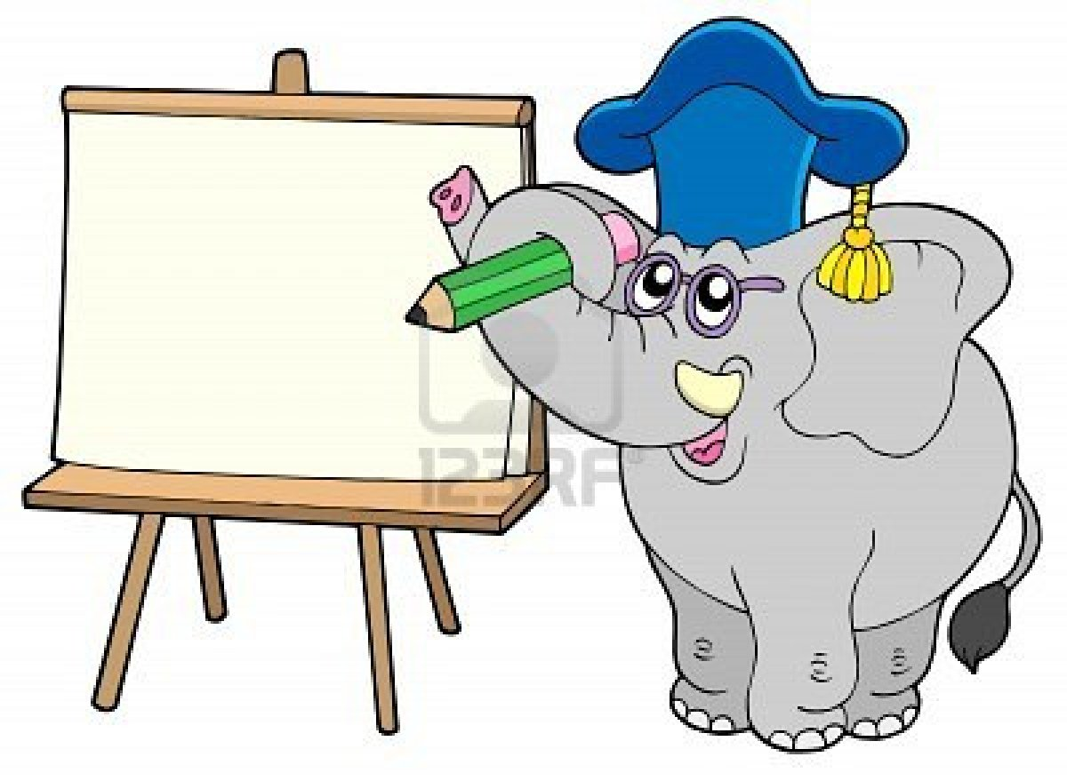
Write it
4
3
_____ _____ _____ _____
2
1

Slide 14
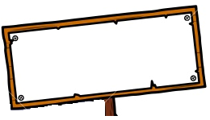
Show me!
4
3
Whose bottle is this?
2
1

Slide 15
4
3
Everyone head down
2
1

Slide 16
Elephant 1
4
3
has
2
1

Slide 17
Sleeping Elephants
4
3
2
1

Slide 18
Elephant 2
4
3
pink
2
1

Slide 19
Sleeping Elephants
4
3
2
1

Slide 20
Elephant 3
4
hearts.
3
2
1

Slide 21
Sleeping Elephants
4
3
2
1

Slide 22
Elephant 4
It
4
3
2
1

Slide 23
Sleeping Elephants
4
3
2
1

Slide 24
Make a word..
4
3
2
1

Slide 25
Write it
4
3
_____ _____ _____ _____
2
1

Slide 26
Show me!
4
3
It has pink hearts.
2
1

Slide 27
4
3
Everyone head down
2
1

Slide 28
Go to sleep…
4
3
2
1

Slide 29
Elephant 1
4
3
this
2
1

Slide 30
Sleeping Elephants
4
3
2
1

Slide 31
Elephant 2
4
3
Is
2
1

Slide 32
Sleeping Elephants
4
3
2
1

Slide 33
Elephant 3
4
watch?
3
2
1

Slide 34
Sleeping Elephants
4
3
2
1

Slide 35
Elephant 4
your
4
3
2
1

Slide 36
Sleeping Elephants
4
3
2
1

Slide 37
Wake Up!
4
3
2
1

Slide 38
Write it
4
3
_____ _____ _____ _____
2
1

Slide 39
Show me!
4
3
Is this your watch?
2
1

Slide 40
4
3
Everyone head down
2
1

Slide 41
Elephant 1
4
3
together.
2
1

Slide 42
Sleeping Elephants
4
3
2
1

Slide 43
Elephant 2
4
3
it
2
1

Slide 44
Sleeping Elephants
4
3
2
1

Slide 45
Elephant 3
4
Let's
3
2
1

Slide 46
Sleeping Elephants
4
3
2
1

Slide 47
Elephant 4
find
4
3
2
1

Slide 48
Sleeping Elephants
4
3
2
1

Slide 49
Wake Up!
4
3
2
1

Slide 50
Write it
4
3
_____ _____ _____ _____
2
1

Slide 51
Show me!
4
3
Let's find it together.
2
1

Slide 52
4
3
Everyone head down
2
1

Slide 53
Elephant 1
4
3
is
2
1

Slide 54
Sleeping Elephants
4
3
2
1

Slide 55
Elephant 2
4
3
Whose
2
1

Slide 56
Sleeping Elephants
4
3
2
1

Slide 57
Elephant 3
4
phone
3
2
1

Slide 58
Sleeping Elephants
4
3
2
1

Slide 59
Elephant 4
this?
4
3
2
1

Slide 60
Sleeping Elephants
4
3
2
1

Slide 61
Wake Up!
4
3
2
1

Slide 62
Write it
4
3
_____ _____ _____ _____
2
1

Slide 63
Show me!
4
3
Whose phone is this?
2
1

Slide 64
Go to sleep…
4
3
2
1

Slide 65
Elephant 1
4
3
green
2
1

Slide 66
Sleeping Elephants
4
3
2
1

Slide 67
Elephant 2
4
3
circles.
2
1

Slide 68
Sleeping Elephants
4
3
2
1

Slide 69
Elephant 3
4
It
3
2
1

Slide 70
Sleeping Elephants
4
3
2
1

Slide 71
Elephant 4
has
4
3
2
1

Slide 72
Sleeping Elephants
4
3
2
1

Slide 73
Wake Up!
4
3
2
1

Slide 74
Write it
4
3
_____ _____ _____ _____
2
1

Slide 75
Show me!
4
3
It has green circles.
2
1

Slide 76
Go to sleep…
4
3
2
1

Slide 77
Elephant 1
4
3
watch
2
1

Slide 78
Sleeping Elephants
4
3
2
1

Slide 79
Elephant 2
4
3
this?
2
1

Slide 80
Sleeping Elephants
4
3
2
1

Slide 81
Elephant 3
4
is
3
2
1

Slide 82
Sleeping Elephants
4
3
2
1

Slide 83
Elephant 4
Whose
4
3
2
1

Slide 84
Sleeping Elephants
4
3
2
1

Slide 85
Wake Up!
4
3
2
1

Slide 86
Write it
4
3
_____ _____ _____ _____
2
1

Slide 87
Show me!
4
3
Whose watch is this?
2
1

Slide 88
Go to sleep…
4
3
2
1

Slide 89
Elephant 1
4
3
star.
2
1

Slide 90
Sleeping Elephants
4
3
2
1

Slide 91
Elephant 2
4
3
It has
2
1

Slide 92
Sleeping Elephants
4
3
2
1

Slide 93
Elephant 3
4
yellow
3
2
1

Slide 94
Sleeping Elephants
4
3
2
1

Slide 95
Elephant 4
a
4
3
2
1

Slide 96
Sleeping Elephants
4
3
2
1

Slide 97
Wake Up!
4
3
2
1

Slide 98
Write it
4
3
_____ _____ _____ _____ _____
2
1

Slide 99
Show me!
4
3
It has a yellow star.
2
1

